Slide 1


Neural Dependency Parser
Aditya Sharma (2021201016)
Rishu Toshniwal (2021201043)
Rahul Katyal (2021201083)

Slide 2
What is dependency Parser?
A dependency parser is a type of natural language processing tool that is used to analyze the grammatical structure of a sentence.
It identifies the relationships between the words in a sentence and tag corresponding to the word and represents them as a tree-like structure called a dependency tree.
The parser uses various techniques to identify the syntactic relationships between words, including part-of-speech tagging and contextual analysis.
Dependency parsing is commonly used in various NLP tasks, including sentiment analysis, machine translation, and information extraction.

Slide 3
Approaches
Transition based Dependency Parser
Graph based Dependency Parser

Slide 4
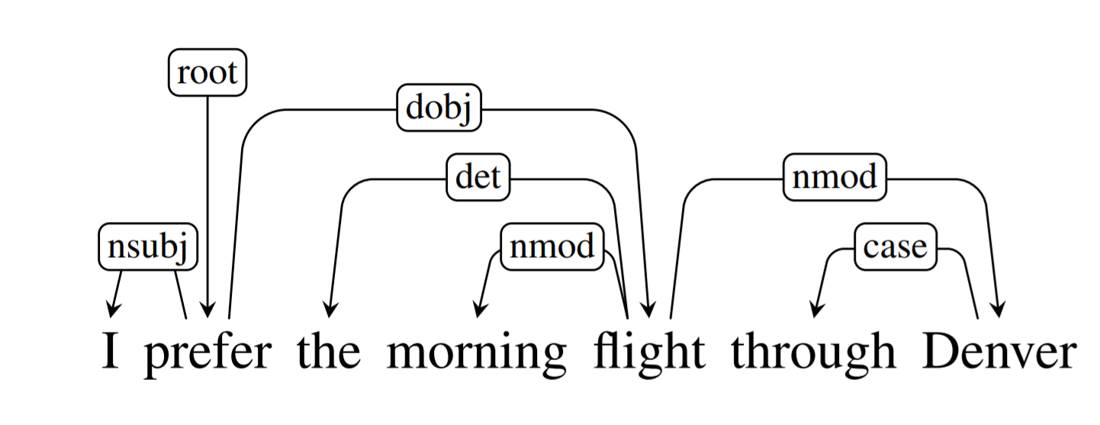
Graph based dependency parser
It will take the sentence as the input and output the dependency tree of the sentence.
We have train and test our dependency parser on English treebank.

Slide 5
Literature Review
The parser is based on a neural network architecture that uses bidirectional LSTMs to encode the input sentence, followed by a graph-based parsing algorithm that constructs the dependency tree by iteratively adding edges to the graph.
The parser also incorporates various features, including part-of-speech tags, and word embeddings to improve its accuracy.
Finally, the authors perform an error analysis to investigate the strengths and weaknesses of their parser.
They find that the parser performs particularly well on languages with rich morphology and complex sentence structures, but struggles with languages with simpler structures.
Finally, the authors perform an error analysis to investigate the strengths and weaknesses of their parser.

Slide 6
Word Embeddings
The training corpus is used to embed each word, which results in a 50-dimensional vector.
Each word's POS tag is also encoded as a 10-dimensional vector, and the concatenation of these two vectors is used to represent a pair of words and POS tags.
The resulting sequence of concatenated vectors is used to represent a sentence of length n.
The (word, POS tag) embeddings are initialized using Gensim's Word2Vec method to reduce training time and the risk of overfitting.

Slide 7
By using precomputed word embeddings, the model is less likely to overfit the training data, resulting in better performance.
Words that occur in test data but not in training data are replaced by ‘<unk>’ words since our training would unlikely to handle such words
A sequence of 60-dimensional vectors is generated for a sentence S of length n which is fed into a Bi-directional Long Short Term Memory Network (Bi-LSTM) to capture long-range dependencies between words in the sentence.
The use of an LSTM is preferred over a traditional RNN to ensure better performance and to facilitate the use of graph-based dependency parsers that are better equipped to capture long-range dependencies.

Slide 8
Training
The network outputs two outputs for each sentence in the training corpus: an n*n adjacency matrix and an n*l matrix.
The adjacency matrix reflects the weight of an arc, with the head denoted by "j" and the dependent by "i," and represents a probability distribution over potential heads.
The n*l matrix represents a probability distribution over labels to gold arcs, with the weight that the ith label gives to the gold arc whose dependent is the jth word as the entry at (j, i).
The cross-entropy loss is computed between the predicted and gold adjacency matrices and between the predicted and gold label matrices to determine the overall loss for a forward pass of the model on a sentence.
The combination of the two losses in this manner amounts to performing multi-task learning using the same network to predict both arc and labels.

Slide 9
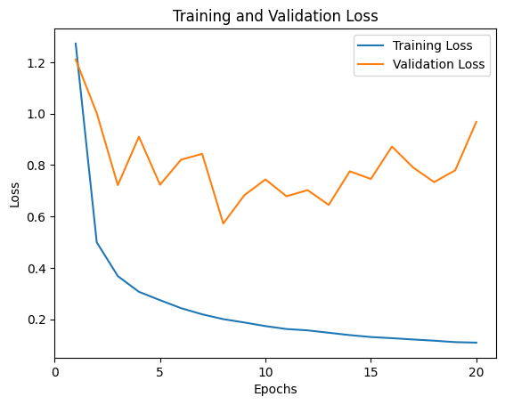
Results
Following is the graph of training versus validation loss for the 20 epochs:

Slide 10
After training the model for 20 epochs, we tested its accuracy on the test data for labeled dependency prediction and unlabeled dependency prediction: Unlabeled Dependency Prediction represents: (word : parent word) Labeled Dependency Prediction represents: (word : parent word : dependency relation between the two)
Unlabeled Dependency Prediction | 88.67579908675799
Labeled Dependency Prediction | 83.33333333333334

Slide 11
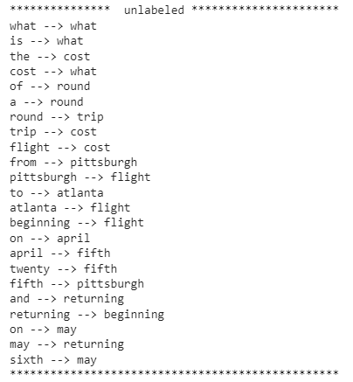
Example of unlabeled dependency parse tree on a sentence:

Slide 12
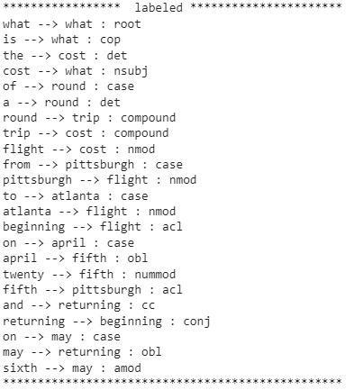
Example of labeled dependency parse tree on a sentence:

Slide 13
References
https://aclanthology.org/K17-3002/
https://towardsdatascience.com/natural-language-processing-dependency-parsing-cf094bbbe3f7
https://nlp.stanford.edu/software/nndep.html

Slide 14
Thank You

